Slide 1
GridLAB-D Tutorial
ECpE Department
GRA: Rui Cheng
Advisor: Dr. Zhaoyu Wang
Department of Electrical and Computer Engineering
Iowa State University

Slide 2
Outline
What is GridLAB-D
  Introduction to GirdLAB-D
  GridLAB-D Key Attributes
  Installing GridLAB-D
  Getting Help
GridLAB-D Module
  Power flow
  Residential
  Generator
  Tape
Test System Modeling and Simulation
  IEEE 4 Node Test Feeder
  Code
  Run snapshot power flow
  Result
ECpE Department

Slide 3

What is GridLAB-D
Introduction to GridLAB-D
  GridLAB-D is a power system simulation tool
  It provides valuable information to users who design and operate electric power transmission and distribution systems, and to utilities that wish to take advantage of the latest smart grid technology.
  It contains many power system models, including overhead line, HVAC, PV, battery, load and so on.
ECpE Department

Slide 4
Outline
What is GridLAB-D
  Introduction to GirdLAB-D
  GridLAB-D Key Attributes
  Installing GridLAB-D
  Getting Help
GridLAB-D Module
  Power flow
  Residential
  Generator
  Tape
Test System Modeling and Simulation
  IEEE 4 Node Test Feeder
  Code
  Run snapshot power flow
  Result
ECpE Department

Slide 5
What is GridLAB-D
GridLAB-D Key Attributes
  Open Source
    Code is readily available for inspection
    Correction or expansion of the code base to meet the user’s particular need is possible.
  Command-Line
    Pure command-line program
    No GUI for user
    Import commands into a system terminal or command line
ECpE Department

Slide 6
What is GridLAB-D
GridLAB-D Key Attributes
  Object-Based
    Module:
    The collection of classes that are related
    It groups common parameters and solvers
    Class:
    It defines similar objects
    Properties are the same for all objects,
    but set parametrically
    Static classes are pre-compiled
    Object:
    Instances of classes
    Used to define the different agents in the system
    Each property is assigned an individualized value
ECpE Department

Slide 7
What is GridLAB-D
GridLAB-D Key Attributes
  Multi-Domain Models
  GridLAB-D is commonly represented as a distribution system and/or smart grid simulator with incredibly useful built-in classes that are more than what you might find in a traditional distribution system simulator
  It contains classes for all may common distribution components(such as transformers, lines, voltage regulators)
  The interactions between multi-domain models are considered.
  Discrete Time
  GridLAB-D is a discrete time simulator
  These simulators are not actually continuous.
  But the time steps used by the simulator are small enough and regularly spaced so as to closely and reasonably approximate continuous time.
ECpE Department

Slide 8
Outline
What is GridLAB-D
  Introduction to GirdLAB-D
  GridLAB-D Key Attributes
  Installing GridLAB-D
  Getting Help
GridLAB-D Module
  Power flow
  Residential
  Generator
  Tape
Test System Modeling and Simulation
  IEEE 4 Node Test Feeder
  Code
  Run snapshot power flow
  Result
ECpE Department

Slide 9
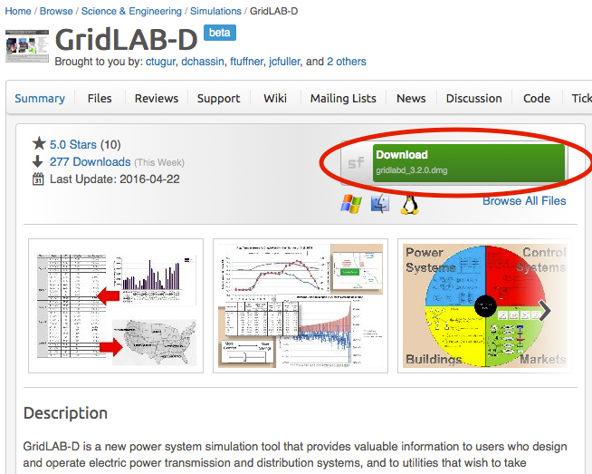
What is GridLAB-D
Installing GridLAB-D: Using a traditional installer
Using a traditional installer:
Website: https://sourceforge.net/projects/gridlab-d/
Once the installer has been downloaded, launch it and walk through the process of installing the software as you would for any other commercial software
ECpE Department

Slide 10

What is GridLAB-D
Installing GridLAB-D
  File Locations (the default directory for GridLAB-D on Windows is as follows):
  c:\Program Files\GridLAB-D
  This is the main GridLAB-D directory. It contains all the subdirectories as well as the readme and uninstall files.
  c:\Program Files\GridLAB-D\bin
  This contains all the executables. The PATH environment variable should include this directory.
  c:\Program Files\GridLAB-D\etc
  This contains all the runtime files. The GLPATH environment variable should include this directory.
  c:\Program Files\GridLAB-D\lib
  This contains all the module files. Both the PATH and GLPATH environment variables should include this directory.
  c:\Program Files\GridLAB-D\samples
  This contains sample data files.
ECpE Department

Slide 11
What is GridLAB-D
Installing GridLAB-D
  Environment variables:
  PATH: The Windows PATH environment must include both the bin and lib directories.
  GLPATH: GridLAB-D uses the GLPATH environment to find runtime files and module files. It should include at least the etc and lib directories.
  GRIDLAB-D: This should contain the path where GridLAB-D is installed.
ECpE Department

Slide 12
Outline
What is GridLAB-D
  Introduction to GirdLAB-D
  GridLAB-D Key Attributes
  Installing GridLAB-D
  Getting Help
GridLAB-D Module
  Power flow
  Residential
  Generator
  Tape
Test System Modeling and Simulation
  IEEE 4 Node Test Feeder
  Code
  Run snapshot power flow
  Result
ECpE Department

Slide 13
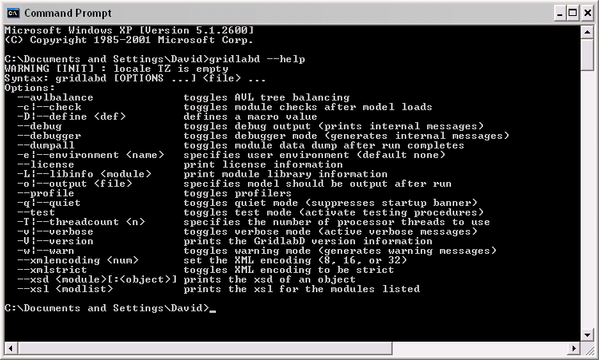
What is GridLAB-D
Getting help
  Running resource: --help, --modhelp module[:class]
Example: --help option
ECpE Department

Slide 14
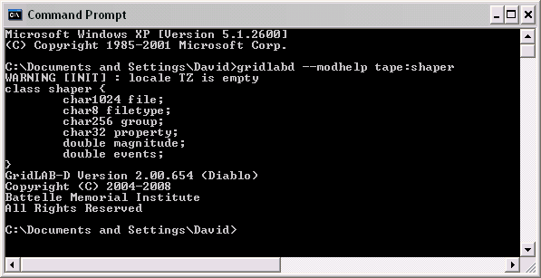
What is GridLAB-D
Getting help:
  Running resource: --help, --modhelp module[:class]
Example: --modhelp tape:shaper
ECpE Department

Slide 15
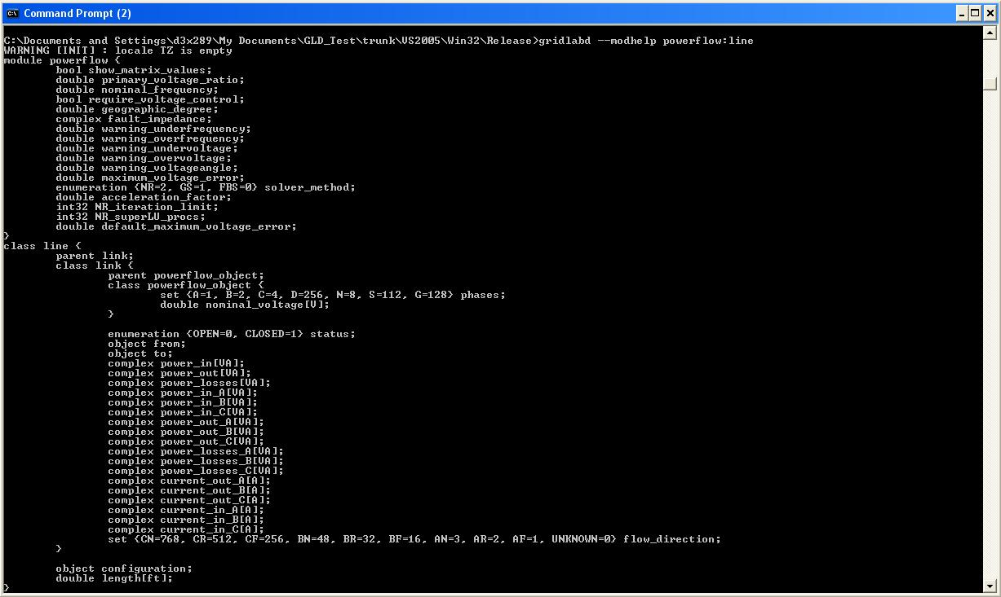
What is GridLAB-D
Example: --modhelp powerflow:line
ECpE Department

Slide 16
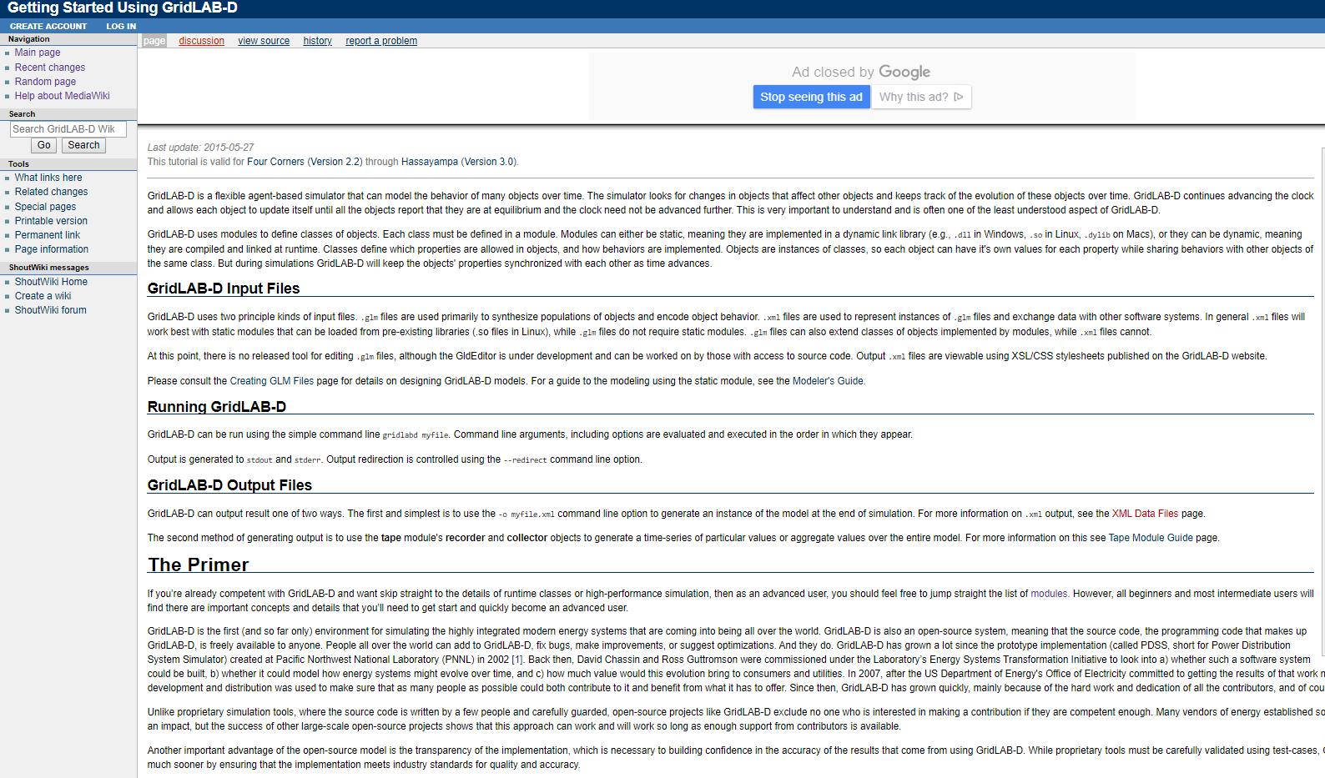
What is GridLAB-D
Getting help
  GridLAB-D wiki pages--These two pages provide earlier attempts to help new user's getting started in GridLAB-D.
http://gridlab-d.shoutwiki.com/wiki/Getting_Started_Using_GridLAB-D
ECpE Department

Slide 17
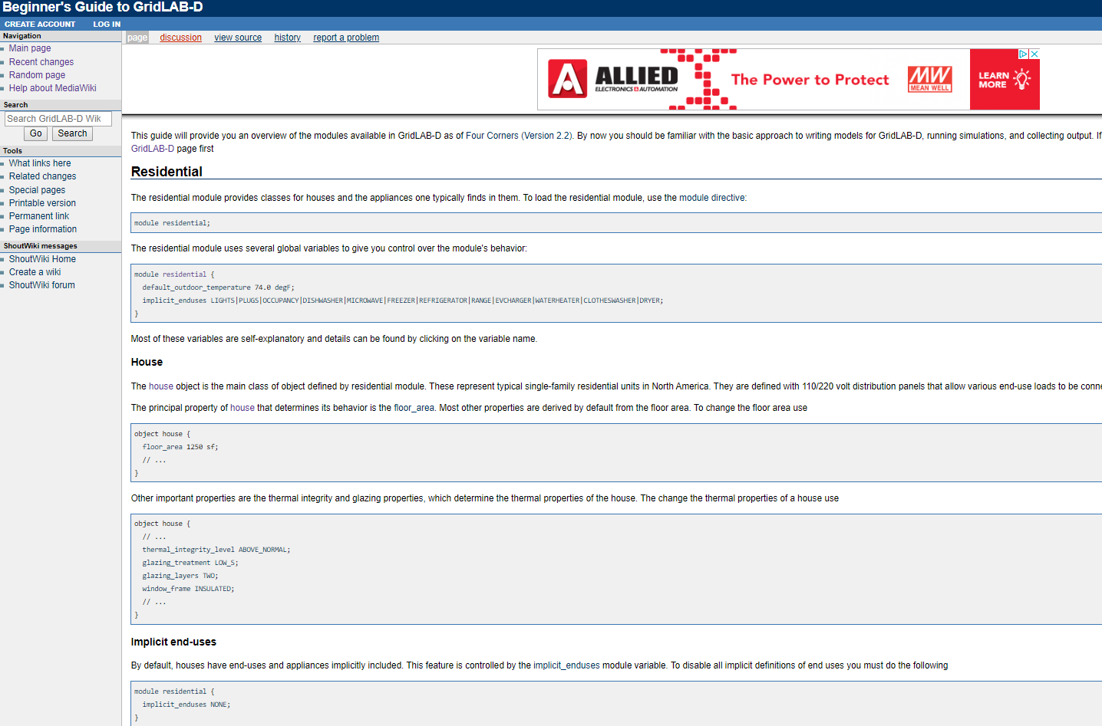
What is GridLAB-D
Getting help
  GridLAB-D wiki pages--These two pages provide earlier attempts to help new user's getting started in GridLAB-D.
http://gridlab-d.shoutwiki.com/wiki/Beginner%27s_Guide_to_GridLAB-D
ECpE Department

Slide 18
Outline
What is GridLAB-D
  Introduction to GirdLAB-D
  GridLAB-D Key Attributes
  Installing GridLAB-D
  Getting Help
GridLAB-D Module
  Power flow
  Residential
  Generator
  Tape
Test System Modeling and Simulation
  IEEE 4 Node Test Feeder
  Code
  Run snapshot power flow
  Result
ECpE Department

Slide 19
GridLAB-D Module
Power flow Module
Classes：
billdump – Billing data dump on meter objects at specified times.
currdump – Current data dump on link object at specified times.
powerflow_library – Abstract class for objects the only contain data but don't synchronize.
  emissions – Emissions library object
  line_configuration – Line configuration library object
  line_spacing – Link spacing library object
  overhead_line_conductor – Overhead conductor library object
  power_metrics – Reliability metrics container
  regulator_configuration – Regulator configuration library object
  restoration – Restoration control library object
  transformer_configuration – Transformer configuration library object
  triplex_line_configuration – Triplex line configuration library object
  underground_line_conductor – Underground line conductor configuration library object
powerflow_object – Abstract class for object the are included in the flow solution
  fault_check – Fault identification object for reliability analysis
  frequency_gen – Frequency generation object
  link – Abstract link (branch) object.
    fuse – Fusable link object.
    line – Generic line object
      overhead_line – Overhead line object
      triplex_line – Triplex line object
      underground_line – Underground line object
ECpE Department

Slide 20
GridLAB-D Module
Power flow Module
Classes：
    regulator – Voltage regulator object
    relay – Relay object
    series_reactor – Series reactor object
    switch_object – Generic switch object
      recloser – Recloser object
      sectionalizer – Sectionalizer object
          transformer – Transformer object
  node – Generic node (bus) object.
    capacitor – Capacity object
    load – Generic load object
      pqload – PQ load object
          meter – Meter object
          motor – Motor object
          substation – Substation object
          triplex_node – Triplex node object
            triplex_meter – Triplex meter object
            volt_var_control – Volt-var controller object
voltdump – Volt data dump on node objects at specified times
ECpE Department

Slide 21
GridLAB-D Module
Power flow Module
  The power flow module performs distribution level solver methods to primarily obtain the voltage and current values in a system.
  Nearly all objects within the power flow module are derived from two primary classes: node and link.
ECpE Department

Slide 22
GridLAB-D Module
Power flow Module
  Node Object
  The node object is equivalent to a bus of the distribution system.
  object node {
  name NodeOne;
  phases ABC;
  nominal_voltage 7200.0;
  voltage_A 7200.0+0d;
  voltage_B 7200.0-120.0d;
  voltage_C 7200.0+120.0d;
  bustype PQ;
  }
Bus type | Description
PQ | PQ for a constant power bus (default)
PV | PV for a voltage-controlled (magnitude) bus
SWING | SWING for the infinite bus of a system.
ECpE Department

Slide 23
GridLAB-D Module
Power flow Module
  Load Object
  Load objects are derived from the node objects
  Load objects provide a means to implement constant current, constant power, and constant impedance losses or generation into the system.
  Loads can be a mixture of the constant current, constant impedance, and constant power types. A typical, mixed load would be implemented as
  object load {
  phases "ABCD";
  name 841;
  constant_current_C -0.586139+9.765222j;
  constant_impedance_B 221.915014+104.430595j;
  constant_power_A 42000.000000+21000.000000j;
  nominal_voltage 4800;
  }
ECpE Department

Slide 24
GridLAB-D Module
Power flow Module
  Link Object
  The link object is a connection between nodes in a distribution system
  object link {
  name Node1toNode2;
  phases ABC;
  from Node1;
  to Node2;
  }
Property Name | Description
from | One connecting end of the link object. This will be the name or reference to a node-based object elsewhere in the power flow model.
to | The other connecting end of the link object. This will be the name or reference to a node-based object elsewhere in the power flow model.
Node1
Node2
Node1toNode2
ECpE Department

Slide 25
GridLAB-D Module
Power flow Module
  Link Object
Link
Overhead Line
Voltage Regulator
Underground Line
Transformer
......
ECpE Department

Slide 26
GridLAB-D Module
Power flow Module
  Overhead Line Object
B
C
Configuration Code
object line_configuration {
name line_configuration_603;
conductor_B overhead_line_conductor_6030;
conductor_C overhead_line_conductor_6030;
conductor_N overhead_line_conductor_6030;
spacing line_spacing_505603;
}
object overhead_line_conductor {
name overhead_line_conductor_6030;
geometric_mean_radius 0.004460;
resistance 1.120000;
}
object line_spacing {
name line_spacing_505603;
distance_BC 7.0 ft;
distance_CN 5.657 ft;
distance_BN 5.0 ft;
}
N
Object Code
object overhead_line {
phases "BCN";
name ohl_632-645;
from node_632;
to load_645;
length 500 ft;
configuration line_configuration_603;
}
ECpE Department

Slide 27
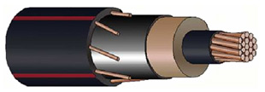
GridLAB-D Module
Power flow Module
  Underground Line Object
Power Conductor
Configuration Code
object line_configuration {
name underground_line_configuration_607;
conductor_A underground_line_conductor_6070;
conductor_N underground_line_conductor_6070;
spacing line_spacing_520;
}
object underground_line_conductor {
name underground_line_conductor_6070;
outer_diameter 1.060000;
conductor_gmr 0.011100;
conductor_diameter 0.368000;
conductor_resistance 0.970000;
neutral_gmr 0.011100;
neutral_resistance 0.970000;
neutral_diameter 0.0640837;
neutral_strands 6.000000;
shield_gmr 0.000000;
shield_resistance 0.000000;
}
object line_spacing {
name line_spacing_520;
distance_AN 0.0833 ft;
}
Underground Cables
Object Code
object underground_line {
phases "AN";
name ugl684-652;
from node_684;
to load-652;
length 800;
configuration line_configuration_607;
}
ECpE Department

Slide 28
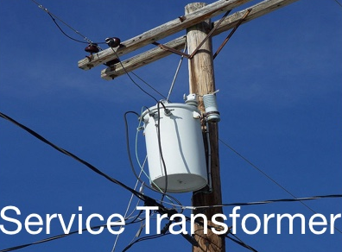
GridLAB-D Module
Power flow Module
  Transformer Object
Configuration Code
object transformer_configuration {
name tc100100B;
connect_type SINGLE_PHASE_CENTER_TAPPED;
install_type POLETOP;
primary_voltage 7200.0;
secondary_voltage 120.0;
power_rating 100.0;
powerB_rating 100.0;
impedance 0.006+0.0136j;
impedance1 0.012+0.0204j;
impedance2 0.012+0.0204j;
shunt_impedance 259200+103680j;
}
Object Code
object transformer {
configuration tc100100B;
name f5_T21400253B;
from f5_L2691959;
to f5_X2691959B;
nominal_voltage 7200;
phases BS;
}
ECpE Department

Slide 29
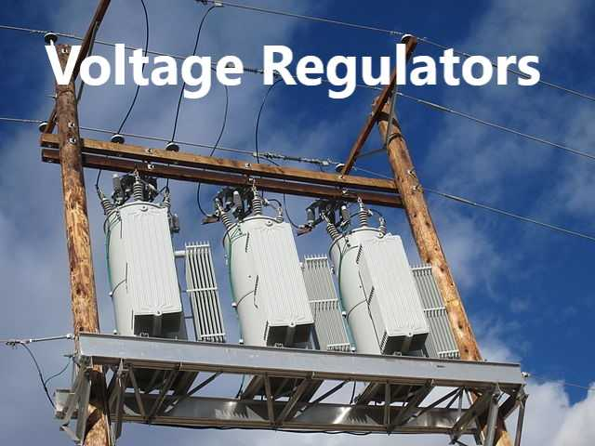
GridLAB-D Module
Power flow Module
  Voltage Regulator Object
Configuration Code
object regulator_configuration {
name regulator_configuration_15;
connect_type WYE_WYE;
band_center 120.000;
band_width 2.0;
time_delay 30.0;
raise_taps 16;
lower_taps 16;
current_transducer_ratio 700;
power_transducer_ratio 20;
compensator_r_setting_A 3.0;
compensator_x_setting_A 7.5;
compensator_r_setting_B 3.0;
compensator_x_setting_B 7.5;
compensator_r_setting_C 3.0;
compensator_x_setting_C 7.5;
CT_phase "ABC";
PT_phase "ABC";
regulation 0.10;
Type A;
tap_pos_A 7;
tap_pos_B 7;
tap_pos_C 7;
Control MANUAL; // OUTPUT_VOLTAGE, // LINE_DROP_COMP or REMOTE NODE
}
Object Code
object regulator {
name reg1501491;
phases "ABC";
from node_150;
to node_1491;
configuration regulator_configuration_15;
}
ECpE Department

Slide 30
GridLAB-D Module
Power flow Module
  Power flow solution methods
Forward/Backward Sweep method
Newton-Raphson method
Forward/Backward Sweep method is also referred to as a ladder solver.
This was one of the first methods developed for unbalanced power flow.
For radial systems this is a very efficient algorithm.
It is unable to solve on a networked or looped system.
Even though a system is radial, there may be components that present a networked appearance.
Overall this is a very good solution method, but it has limitations.
Newton-Raphson Method was originally developed for use on transmission level analysis.
They are based on the power injections at each node, both real and reactive power.
These power injections are then used to update the voltage magnitude and voltage angle.
The NR method requires the calculation, and inversion of a Jacobian which is computationally intensive.
ECpE Department

Slide 31
GridLAB-D Module
Power flow Module
  Power Flow Solution Methods
module powerflow {
solver_method FBS;
//In this module, FBS method is selected to calculate power flow.
default_maximum_voltage_error 1e-6;
//Define convergence criteria
NR_iteration_limit 50;
//Maximum iteration is 50
}
As implemented, FBS is faster.
As implemented, NR handles meshed systems, reconfiguration algorithms, and reliability.
Method to be used depends upon application, but both methods currently work with all objects in power flow and all other modules (except reconfiguration and reliability).
ECpE Department

Slide 32
Outline
What is GridLAB-D
  Introduction to GirdLAB-D
  GridLAB-D Key Attributes
  Installing GridLAB-D
  Getting Help
GridLAB-D Module
  Power flow
  Residential
  Generator
  Tape
Test System Modeling and Simulation
  IEEE 4 Node Test Feeder
  Code
  Run snapshot power flow
  Result
ECpE Department

Slide 33
GridLAB-D Module
Residential Module
Common Classes
    house – Single-family home model.
    ZIPload – Generic constant impedance/current/power end-use load.
  As of Hassayampa (Version 3.0)
  These may be available in earlier versions but they have not been validated and are not supported.
  lights – Typical residential lights.
  occupantload – Residential occupants (sensible and latent heat).
  plugload – Typical residential plug loads.
ECpE Department

Slide 34
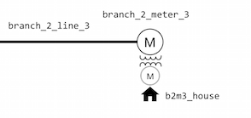
GridLAB-D Module
Residential Module
  House Object
It attaches to the power system via a meter. (meter is parent of house)
Thermal dynamics are expressed by an Equivalent Thermal Parameter (ETP) model.
It can simulate heat flow of the house.
Object Code
object house {
name house_114A_3; parent triplex_meter_114A_3;
//‘parent’ means house_114A_3 is connected with meter_114A_3.
air_temperature 72;mass_temperature 72;cooling_COP 3.5;
over_sizing_factor 0.0;ceiling_height 8;number_of_stories 1;
aspect_ratio 1.5;floor_area 864;mass_internal_gain_fraction 0.5;
mass_solar_gain_fraction 0.5;glass_type GLASS;glazing_layers TWO;
airchange_per_hour 1.5;Rroof 19;Rdoors 3;Rfloor 4;Rwall 11;
};
ECpE Department

Slide 35
GridLAB-D Module
Residential Module
  House Object
The types of equipment that form a residential heating/ventilating/air conditioning (HVAC)system is defined in House object by the input parameters.
System_mode: heating/cooling system operation state
system_mode | Description
UNKNOWN | When system_mode is set to UNKNOWN, it will be set to OFF
OFF | Neither the heating, auxiliary heating nor cooling system is currently in operation.
COOL | The cooling system is in operation (if it exists).
HEAT | The heating system is in operation (if it exists).
AUX | The auxiliary heating system is operating (if it exists).
Default: If system_mode is not set, it is assumed that system_mode is OFF.
ECpE Department

Slide 36
GridLAB-D Module
Residential Module
  House Object
heating_system_type: Type of heating system in the house
heating_system_type | Description
NONE | No heating system exists.
HEAT_PUMP | Specifies that heat is provided by heat pump that is a reversible vapor compression cycle
RESISTANCE | Specifies that heat is provided by an electric resistance heating coil
GAS | Specifies that heat is provided by a gas-powered furnace or boiler
Default: When heating_system_type is not set, it is assumed that the heating system of the house is HEAT_PUMP.
ECpE Department

Slide 37
GridLAB-D Module
Residential Module
  House Object
cooling_system_type: Cooling system in house
cooling_system_type | Description
NONE | No air-conditioning provided.
ELECTRIC | Forced-air vapor-compression cooling, representing either a central air conditioner or a window/wall unit that cycles on and off to maintain air_temperature below the cooling thermostat set point.
HEAT_PUMP | Not used
Deafult: If no cooling_system_type is set, it is assumed to be NONE.
ECpE Department

Slide 38
GridLAB-D Module
Residential Module
  House Object
auxiliary_system_type：specify auxiliary heat for heat pump heating_system_type.
cooling_system_type | Description
NONE | No air-conditioning provided.
ELECTRIC | Forced-air vapor-compression cooling, representing either a central air conditioner or a window/wall unit that cycles on and off to maintain air_temperature below the cooling thermostat set point.
HEAT_PUMP | Not used
ECpE Department

Slide 39
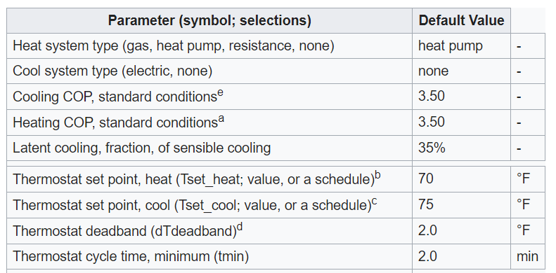
GridLAB-D Module
Residential Module
  House Object
Primary Inputs
ECpE Department

Slide 40
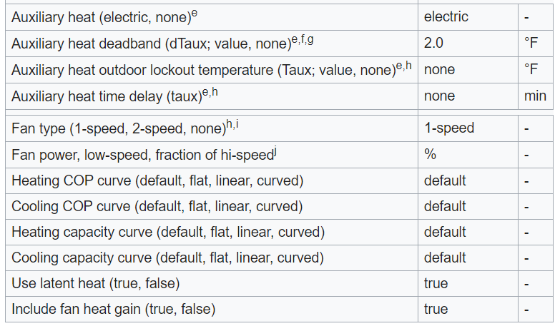
GridLAB-D Module
Residential Module
  House Object
Primary Inputs
ECpE Department

Slide 41
GridLAB-D Module
Residential Module
  ZIP load Object
It contains a classic ZIP load model (constant impedance, current, and power)
Where:
Pi: Real power consumption of ith load; Qi: Reactive power consumption of ith load.
Va: Actual terminal voltage; Vn: Nominal terminal voltage
Sn: Apparent Power Consumption at nominal voltage; Z%: Percent of load that is constant impedance
I%:Percent of load that is constant current; P%:Percent of load that is constant power
Z :Phase angle of constant impedance fraction; I :Phase angle of constant current fraction.
P :Phase angle of constant power fraction.
object ZIPload {
name house1_load; parent house1;
base_power responsive_loads*1.06; heatgain_fraction 0.90;
power_pf 1.0;current_pf 1.0;impedance_pf 1.0;
impedance_fraction 0.20;current_fraction 0.40;power_fraction 0.40;
};
ECpE Department

Slide 42
Outline
What is GridLAB-D
  Introduction to GirdLAB-D
  GridLAB-D Key Attributes
  Installing GridLAB-D
  Getting Help
GridLAB-D Module
  Power flow
  Residential
  Generator
  Tape
Test System Modeling and Simulation
  IEEE 4 Node Test Feeder
  Code
  Run snapshot power flow
  Result
ECpE Department

Slide 43
GridLAB-D Module
Generator Module
Classes
battery – battery model
diesel_dg –
  PQ_CONSTANT mode diesel_dg – The diesel_dg with predefined P and Q output
dc_dc_converter –
energy_storage –
inverter – converts DC (solar, battery, etc.) to AC
  Droop inverter – The inverter with droop mode enabled
  Voltage source inverter (VSI) – The isochronous mode and droop mode VSI
microturbine –
power_electronics –
rectifier –
solar – solar panel
windturb_dg –
ECpE Department

Slide 44
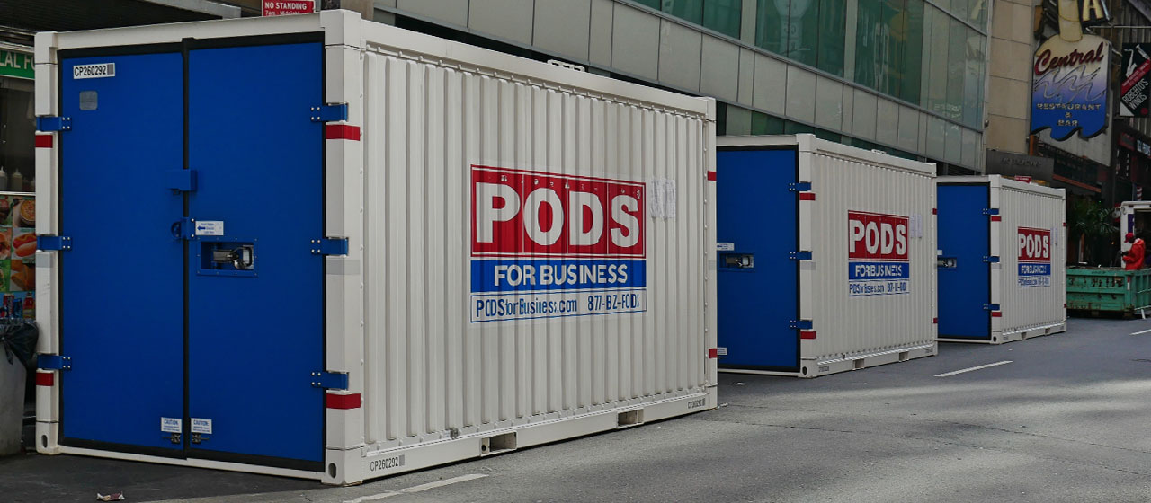
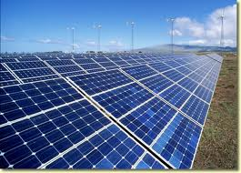
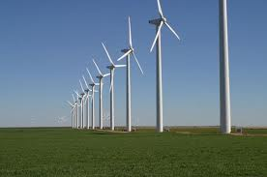
GridLAB-D Module
Generator Module
Designed to model distributed energy resource (DER). Sometimes also referred as distributed generation.
Photovoltaic
Battery
Wind
ECpE Department

Slide 45
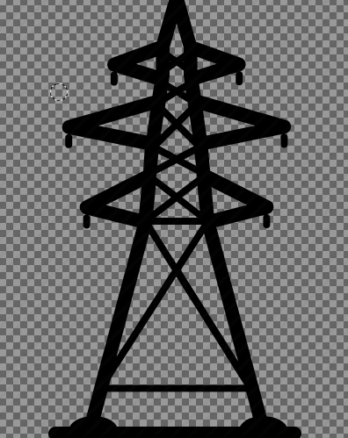

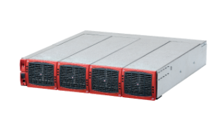
GridLAB-D Module
Generator Module
  Solar Object
DC
AC
Solar
Inverter
Grid
Solar object must have inverter as its parent.
DC networks are not currently supported
Power flow sees it as a current injection and negative load
ECpE Department

Slide 46
GridLAB-D Module
Generator Module
  Solar Object
Fixed axis PV object implemented in version 2.3
Needed for most of the residential PV simulation or analysis
User can specify the tilt needed or select a default which is often the latitude of the region selected
object solar {
name trip_solar;
phases AS;
parent trip_inv;
area 29.6296 m^2;
tilt_angle 50.0;
efficiency 0.135;
orientation_azimuth 25.0;
orientation FIXED_AXIS;
};
ECpE Department

Slide 47
GridLAB-D Module
Generator Module
  Inverter Object
It converts DC power to AC power
All the dc power generating distributed resources should have inverter as its parent object.
Constant PF mode allows the user to set any power factor to regulate the reactive power within the specified inverter rating.
object inverter {
name inv_B_2_645;
phases BS;
generator_mode CONSTANT_PF;
generator_status ONLINE;
inverter_type PWM;
power_factor 1.0;
};
ECpE Department

Slide 48
GridLAB-D Module
Generator Module
  Inverter Object
Control mode | Description
CONSTANT_PQ | Sets the output of the battery to the specified constant real and reactive power levels.
CONSTANT_PF | This is the default controller mode with the power factor set to unity.
VOLT_VAR | Uses the reactive power capability of the inverter to regulate the voltage at the point of common coupling.
LOAD_FOLLOWING | Allows the inverter to use the energy from the battery to regulate the load at a user-definable point on the feeder.
ECpE Department

Slide 49
GridLAB-D Module
Generator Module
  Solar-Inverter System Implementation
object inverter {
name inv_B_2_645;
phases BS;
generator_mode CONSTANT_PF;
generator_status ONLINE;
inverter_type PWM;
power_factor 1.0;
object solar {
name sol_inv_B_2_645;
generator_mode SUPPLY_DRIVEN;
generator_status ONLINE;
panel_type SINGLE_CRYSTAL_SILICON;
efficiency 0.2;
area 450;
};
}
ECpE Department

Slide 50
Outline
What is GridLAB-D
  Introduction to GirdLAB-D
  GridLAB-D Key Attributes
  Installing GridLAB-D
  Getting Help
GridLAB-D Module
  Power flow
  Residential
  Generator
  Tape
Test System Modeling and Simulation
  IEEE 4 Node Test Feeder
  Code
  Run snapshot power flow
  Result
ECpE Department

Slide 51
GridLAB-D Module
Tape Module
Classes
player – Play data into the model
shaper – Generate pulsed or modulated data from averages
recorder – Record data to a stream
  multi_recorder – Record properties from multiple objects
  group_recorder – Records properties of objects designated by class type and group id
  violation_recorder – Records voltage and thermal limit violations as well as reverse flow through a substation
collector – Data aggregation recording
histogram – Property statistics
The tape module implements objects that can be used to establish and change the boundary condition on a model, and observes the properties of individual objects or the aggregate properties of a group of objects.
Player and shaper tapes are used for updating the model at specified times from a file.
Recorder and collector tapes are used for collecting information from the model.
ECpE Department

Slide 52
GridLAB-D Module
Tape Module
  Player Object
  object player {
  name player-name;
  parent target-object-name;
  property target-property-name;
  file output-file-name;
  }
object player {
name player;
parent house1;
property cooling_setpoint;
file “theat,csv”;
}
theat.csv:
2019-01-01 0:00:00,75
+15h,60
+9h,75
From 0:00 to15：00 the cooling set point of house1 is 75F,
From 15:00 to 24:00 the cooling set point of house1 is 60F.
ECpE Department

Slide 53
GridLAB-D Module
Tape Module
  Recorder Object
  object recorder {
  name "recorder-name";
  parent "target-object-name";
  property "target-property-name";
  file "output-file-name";
  interval sampling-interval;
  limit sampling-limit;
  }
  Parent house1 means this recorder records data or property from house1.
  The air temperature and cooling set point are recorded in file theat_record.csv .
  Interval 4800 means the frequency is 4800 seconds each time.
  Limit 48 means the record times is 48.
object recorder {
name recorder1;
parent house1;
property air_temperature, cooling_setpoint;
file theat_record.csv;
interval 1800;
limit 48;
}
ECpE Department

Slide 54
GridLAB-D Module
  Recorder Object
properties
# timestamp | air_temperature | cooling_setpoint
2001-01-01 00:00:00 PST | 60.1805 | 60
2001-01-01 00:30:00 PST | 61.8869 | 60
2001-01-01 01:00:00 PST | 57.2472 | 60
2001-01-01 01:30:00 PST | 60.7869 | 60
2001-01-01 02:00:00 PST | 61.7786 | 60
2001-01-01 02:30:00 PST | 57.0379 | 60
2001-01-01 03:00:00 PST | 60.5776 | 60
2001-01-01 03:30:00 PST | 61.5343 | 60
2001-01-01 04:00:00 PST | 56.8017 | 60
2001-01-01 04:30:00 PST | 60.3734 | 60
2001-01-01 05:00:00 PST | 61.3693 | 60
2001-01-01 05:30:00 PST | 56.8531 | 60
2001-01-01 06:00:00 PST | 60.5573 | 60
2001-01-01 06:30:00 PST | 62.1531 | 60
2001-01-01 07:00:00 PST | 57.9207 | 60
2001-01-01 07:30:00 PST | 62.4451 | 60
2001-01-01 08:00:00 PST | 58.6043 | 60
2001-01-01 08:30:00 PST | 62.8697 | 60
2001-01-01 09:00:00 PST | 58.9204 | 60
2001-01-01 09:30:00 PST | 63.035 | 60
2001-01-01 10:00:00 PST | 58.9531 | 60
2001-01-01 10:30:00 PST | 62.9797 | 60
2001-01-01 11:00:00 PST | 58.8059 | 60
interval :
30min=1800s
ECpE Department

Slide 55
GridLAB-D Module
Tape Module
  Collector Object
  Collectors are different from recorders in that they aggregate multiple object properties into a single value.
  They do not use the parent property but instead use the group property to form a collection of objects over which the aggregate is taken.
  object collector {
  name collector-name;
  group class=class-name;
  property aggregator(property)[,...];
  file "file-name";
  }
  Collect the hourly average indoor air temperature a population of houses.
object collector {
file exercise_2_4_2.csv;
group "class=house";
property “avg(air_temperature)";
interval 3600;
}
ECpE Department

Slide 56
Outline
What is GridLAB-D
  Introduction to GirdLAB-D
  GridLAB-D Key Attributes
  Installing GridLAB-D
  Getting Help
GridLAB-D Module
  Power flow
  Residential
  Generator
  Tape
Test System Modeling and Simulation
  IEEE 4 Node Test Feeder
  Code
  Run snapshot power flow
  Result
ECpE Department

Slide 57
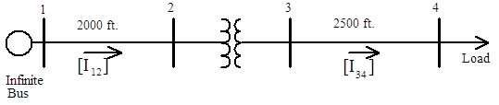
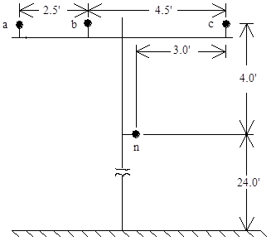
Test System Modeling and Simulation
IEEE 4 Node Test Feeder
Node: 1, 2, 3, 4
Link : 1-2 overhead line12
2-3 transformer23
3-4 overhead line34
ECpE Department

Slide 58
Test System Modeling and Simulation
IEEE 4 Node Test Feeder
object node {
name node1;
bustype SWING;
phases "ABCN";
voltage_A +7199.558+0.000j;
voltage_B -3599.779-6235.000j;
voltage_C -3599.779+6235.000j;
nominal_voltage 7200;
}
ECpE Department

Slide 59
Test System Modeling and Simulation
IEEE 4 Node Test Feeder
object node {
name node2;
phases "ABCN";
voltage_A +7199.558+0.000j;
voltage_B -3599.779-6235.000j;
voltage_C -3599.779+6235.000j;
nominal_voltage 7200;
}
ECpE Department

Slide 60
Test System Modeling and Simulation
IEEE 4 Node Test Feeder
object node {
name node3;
phases "ABCN";
voltage_A +2401.777+0.000j;
voltage_B -1200.889-2080.000j;
voltage_C -1200.889+2080.000j;
nominal_voltage 2400;
}
ECpE Department

Slide 61
Test System Modeling and Simulation
IEEE 4 Node Test Feeder
object load {
name load4;
phases "ABCN";
voltage_A +2401.777+0.000j;
voltage_B -1200.889-2080.000j;
voltage_C -1200.889+2080.000j;
constant_power_A +1800000.000+871779.789j;
constant_power_B +1800000.000+871779.789j;
constant_power_C +1800000.000+871779.789j;
nominal_voltage 2400;
}
ECpE Department

Slide 62
Test System Modeling and Simulation
IEEE 4 Node Test Feeder
object load {
name load4;
phases "ABCN";
voltage_A +2401.777+0.000j;
voltage_B -1200.889-2080.000j;
voltage_C -1200.889+2080.000j;
constant_power_A +1800000.000+871779.789j;
constant_power_B +1800000.000+871779.789j;
constant_power_C +1800000.000+871779.789j;
nominal_voltage 2400;
}
ECpE Department

Slide 63
Test System Modeling and Simulation
IEEE 4 Node Test Feeder
object overhead_line {
name ovl_12;
phases "ABCN";
from node1;
to node2;
length 2000;
configuration line_configuration300;
}
In line_configuration object define the parameters and spacing distribution of line
ECpE Department

Slide 64
Test System Modeling and Simulation
IEEE 4 Node Test Feeder
object line_configuration {
name line_configuration300;
conductor_A overhead_line_conductor100;
conductor_B overhead_line_conductor100;
conductor_C overhead_line_conductor100;
conductor_N overhead_line_conductor101;
spacing line_spacing200;
}
object line_spacing {
name line_spacing200;
distance_AB 2.5;
distance_BC 4.5;
distance_AC 7.0;
distance_AN 5.656854;
distance_BN 4.272002;
distance_CN 5.0;
}
ECpE Department

Slide 65
Test System Modeling and Simulation
IEEE 4 Node Test Feeder
object line_configuration {
name line_configuration300;
conductor_A overhead_line_conductor100;
conductor_B overhead_line_conductor100;
conductor_C overhead_line_conductor100;
conductor_N overhead_line_conductor101;
spacing line_spacing200;
}
object overhead_line_conductor {
name overhead_line_conductor101;
geometric_mean_radius 0.00814;
resistance 0.592;
}
object overhead_line_conductor {
name overhead_line_conductor101;
geometric_mean_radius 0.00814;
resistance 0.592;
}
ECpE Department

Slide 66
Test System Modeling and Simulation
IEEE 4 Node Test Feeder
object transformer_configuration {
name transformer_configuration400;
connect_type 1;
power_rating 6000;
powerA_rating 2000;
powerB_rating 2000;
powerC_rating 2000;
primary_voltage 12470;
secondary_voltage 4160;
resistance 0.01;
reactance 0.06;
}
ECpE Department

Slide 67
Test System Modeling and Simulation
IEEE 4 Node Test Feeder
object overhead_line {
name ovl_34;
phases "ABCN";
from node3;
to load4;
length 2500;
configuration line_configuration300;
}
ECpE Department

Slide 68
Outline
What is GridLAB-D
  Introduction to GirdLAB-D
  GridLAB-D Key Attributes
  Installing GridLAB-D
  Getting Help
GridLAB-D Module
  Power flow
  Residential
  Generator
  Tape
Test System Modeling and Simulation
  IEEE 4 Node Test Feeder
  Code
  Run snapshot power flow
  Result
ECpE Department

Slide 69
Test System Modeling and Simulation
Code
clock {
timestamp '2000-01-01 0:00:00';
timezone EST+5EDT;
}
module powerflow {
solver_method NR;
}
object overhead_line_conductor {
name overhead_line_conductor100;
geometric_mean_radius 0.0244;
resistance 0.306;
}
object overhead_line_conductor {
name overhead_line_conductor101;
geometric_mean_radius 0.00814;
resistance 0.592;
}
Simulation time
Snapshot power flow
Power flow method,
NR method is selected.
Overhead line parameters
ECpE Department

Slide 70
Test System Modeling and Simulation
Code
object line_spacing {
name line_spacing200;
distance_AB 2.5;
distance_BC 4.5;
distance_AC 7.0;
distance_AN 5.656854;
distance_BN 4.272002;
distance_CN 5.0;
}
object line_configuration {
name line_configuration300;
conductor_A overhead_line_conductor100;
conductor_B overhead_line_conductor100;
conductor_C overhead_line_conductor100;
conductor_N overhead_line_conductor101;
spacing line_spacing200;
}
Overhead line spacing distribution
Overhead line configuration
ECpE Department

Slide 71
Test System Modeling and Simulation
Code
object transformer_configuration {
name transformer_configuration400;
connect_type 1;
power_rating 6000;
powerA_rating 2000;
powerB_rating 2000;
powerC_rating 2000;
primary_voltage 12470;
secondary_voltage 4160;
resistance 0.01;
reactance 0.06;
}
object node {
name node1;
bustype SWING;
phases "ABCN";
voltage_A +7199.558+0.000j;
voltage_B -3599.779-6235.000j;
voltage_C -3599.779+6235.000j;
nominal_voltage 7200;
}
Transformer parameters
Node1
ECpE Department

Slide 72
Test System Modeling and Simulation
Code
object transformer_configuration {
name transformer_configuration400;
connect_type 1;
power_rating 6000;
powerA_rating 2000;
powerB_rating 2000;
powerC_rating 2000;
primary_voltage 12470;
secondary_voltage 4160;
resistance 0.01;
reactance 0.06;
}
object node {
name node1;
bustype SWING;
phases "ABCN";
voltage_A +7199.558+0.000j;
voltage_B -3599.779-6235.000j;
voltage_C -3599.779+6235.000j;
nominal_voltage 7200;
}
Transformer parameters
Node1
ECpE Department

Slide 73
Test System Modeling and Simulation
Code
object transformer {
name transformer23;
phases "ABCN";
from node2;
to node3;
configuration transformer_configuration400;
}
object node {
name node3;
phases "ABCN";
voltage_A +2401.777+0.000j;
voltage_B -1200.889-2080.000j;
voltage_C -1200.889+2080.000j;
nominal_voltage 2400;
}
object overhead_line {
phases "ABCN";
from node1;
to node2;
length 2000;
configuration line_configuration300;
}
object node {
name node2;
phases "ABCN";
voltage_A +7199.558+0.000j;
voltage_B -3599.779-6235.000j;
voltage_C -3599.779+6235.000j;
nominal_voltage 7200;
}
ECpE Department

Slide 74
Test System Modeling and Simulation
Code
object overhead_line:34 {
phases "ABCN";
from node3;
to load4;
length 2500;
configuration line_configuration300;
}
object load {
name load4;
phases "ABCN";
voltage_A +2401.777+0.000j;
voltage_B -1200.889-2080.000j;
voltage_C -1200.889+2080.000j;
constant_power_A +1800000.000+871779.789j;
constant_power_B +1800000.000+871779.789j;
constant_power_C +1800000.000+871779.789j;
nominal_voltage 2400;
}
ECpE Department

Slide 75
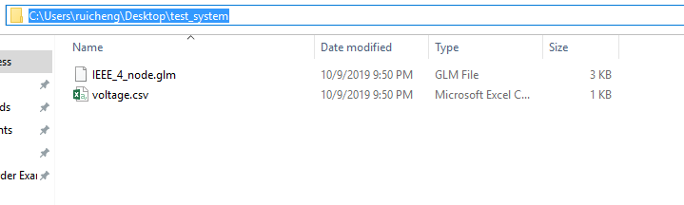
Test System Modeling and Simulation
Code
  The code is saved in IEEE_4_node.glm, which is in the directory: C:\Users\ruicheng\Desktop\test_system (in my computer).
  The voltages of all nodes are recorded in the file named voltage.csv by using recorder object.
  object multi_recorder {
  property node1:voltage_A,node1:voltage_B,node1:voltage_C,
  node2:voltage_A,node2:voltage_B,node2:voltage_C,
  node3:voltage_A,node3:voltage_B,node3:voltage_C,
  load4:voltage_A,load4:voltage_B,load4:voltage_C;
  file "voltage.csv";
  }
ECpE Department

Slide 76
Outline
What is GridLAB-D
  Introduction to GirdLAB-D
  GridLAB-D Key Attributes
  Installing GridLAB-D
  Getting Help
GridLAB-D Module
  Power flow
  Residential
  Generator
  Tape
Test System Modeling and Simulation
  IEEE 4 Node Test Feeder
  Code
  Run snapshot power flow
  Result
ECpE Department

Slide 77
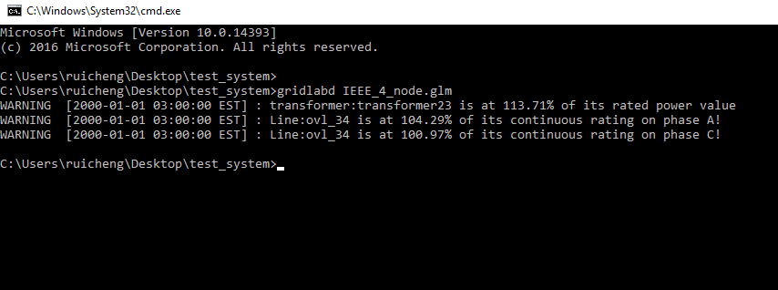
Test System Modeling and Simulation
Operation Procedure
  Open CMD, and change the directory to:
  C:\Users\ruicheng\Desktop\test_system
  Input the command: “gridlabd IEEE_4_node.glm” in CMD.
ECpE Department

Slide 78
Outline
What is GridLAB-D
  Introduction to GirdLAB-D
  GridLAB-D Key Attributes
  Installing GridLAB-D
  Getting Help
GridLAB-D Module
  Power flow
  Residential
  Generator
  Tape
Test System Modeling and Simulation
  IEEE 4 Node Test Feeder
  Code
  Run snapshot power flow
  Result
ECpE Department

Slide 79
Test System Modeling and Simulation
Result
node1:voltage_A | node1:voltage_B | node1:voltage_C
+7199.56+0j | -3599.78-6235j | -3599.78+6235j
node2:voltage_A | node2:voltage_B | node2:voltage_C
+7106.42-42.0676j | -3606.9-6161.63j | -3520.34+6189.71j
node3:voltage_A | node3:voltage_B | node3:voltage_C
+2242.74-144.808j | -1251.27-1892.2j | -1002.84+2020.69j
load4:voltage_A | load4:voltage_B | load4:voltage_C
+1893.76-302.435j | -1277.97-1617.28j | -705.201+1850.98j
ECpE Department

